Slide 1

Prototype of a Data driven system to pick best suited candidates for unemployment subsidies in a Covid-19 crisis scenario
Daniel Osorio, Laura Bermudez, Tomás S. Gómez

Slide 2

Table of contents
Introduction and problem statement
Solution pitch
Solution Description
Exploratory Data Analysis (EDA)
Data cleaning
Model trial
Model prediction
Conclusions: Implications of this project in a new normal

Slide 3
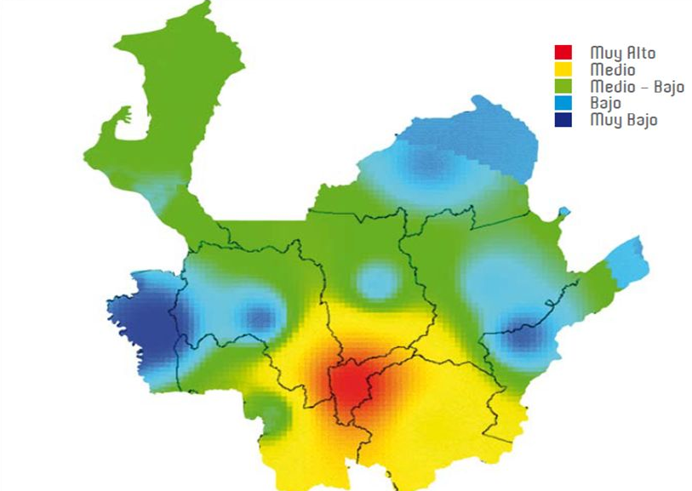
Business understanding - Problem Statement Antioquia
Economic Distress
Strict Quarantine in the state of Antioquia
Regionalized programs for subsidies
Limited resources
Order or arrival handouts
Vulnerable to conscious or unconscious biases
Antioquia’s estimated population: 6.5 M
National unemployment rate: 20.2%
National minimum wage: 229.22 USD
Notes:
Due to the economic distress caused by the sudden decision to start a strict quarantine in the state of Antioquia, the unemployment rate soared to levels unseen since the last decade. The Colombian government has several regionalized programs to handout subsidies to the population. As the funds for the financial aids are limited, it often happens that the subsidies are distributed in order of arrival, whereas further analysis should be made to determine whether it should be given or not. On the other hand, the process is vulnerable to conscious and unconscious biases by the agents.

Slide 4
Solution Pitch
A possible solution to such issues is to develop a data driven solution that based on different characteristics of the individual asking for financial aid determines whether or not it is granted.
Data exploration and identification by visualization
Data cleaning and codification of categorical data into numerical using one hot encoding and binary logic
Prediction variable selection, model selection from model exploration results.
Model implementation, prediction and metric development.
Notes:
A possible solution to such issues is to develop a data driven solution that based on different characteristics of the individual asking for financial aid determines whether or not it is granted.
Valuable Data selection: To build such prototype we took a dataset from applications to a unemployment subsidy granted by a family compensation fund in the region of Antioquia
Data exploration and identification through an EDA we identified the fields that the data had, and started to gain insights on which could be useful
We made an EDA, data cleaning and a predictive model which would qualify if an applicant is eligible or not using a logistic regression

Slide 5
Solution Description - Data exploration and Id
At first the raw data included a great amount of data which had no use:
Loading the data and recognizing what each column contained was crucial to determine the variables that had to stay in the model and those to be discarded
Plotting to explore data distribution
After performing a first round of cleaning and dropping fields that were not useful for analytics purposes the fields that remained were the following
Notes:
At first the raw data included a great amount of data which had no use:
Loading the data into data frames and recognizing the type of data that each column included was crucial to determine the variables that had to stay in the model and those to be discarded
We decided to drop fields such as id. number since it was not valuable for predictions, also as the metro area of medellín concentrates most of the population of Antioquia, and most applicants came from here, thos colomn were dropped

Slide 6
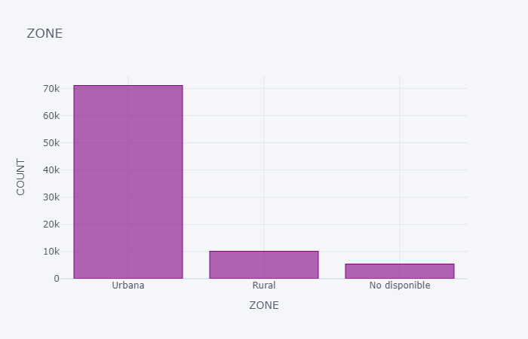
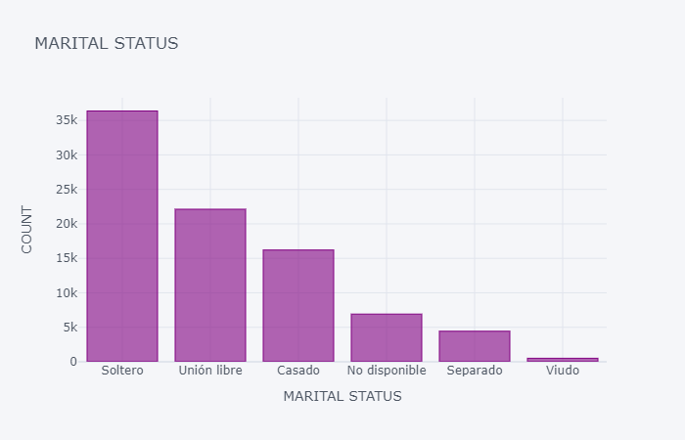
Solution Description - Data exploration and Id

Slide 7
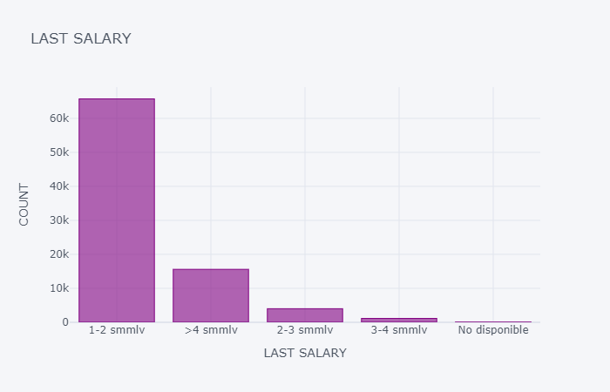
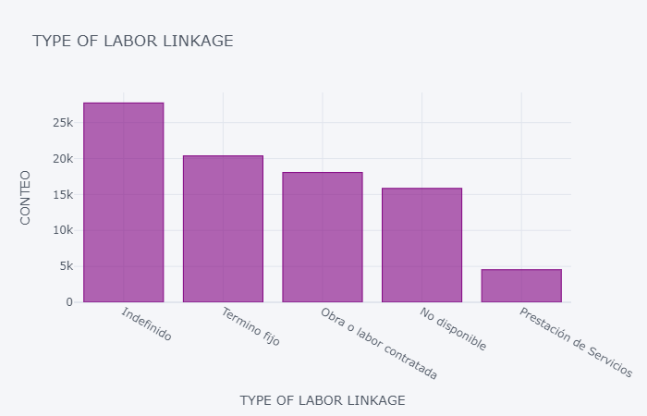
Solution Description - Data exploration and Id

Slide 8
Solution Description - Data exploration and id
Document type
Id number
Gender
Civil status
Municipality
Ethnicity
type of population
Last salary
Status of request
last type of laboral contract
Previous unemployment subsidy
in charge of persons
Complies with requirements for subsidy (This will be our prediction variable)
Delete: Id number, Municipality, last type of laboral contract, Status of request
Keep binarize / one hot encoding: Gender, civil status (one hot encoding), ethnicity type of population(Merge and binarize), previous unemployement subsidy, in charge of persons
Notes:
The more important fields found in the data source are the following, here we will explain why we took some decisions on data cleaning or dropping certain fields
**1 Document type**: Represents the type of document used by the users to apply for the subsidies, this field does is mostly registers of the national identity card, therefore, this field will be droped as it is not useful for further modeling or analysis
**2. Id number**: Representing the id number of those applying for the subsidy, once again this field does not give us valuable information to predict whether someone is going to be elegible for a subsidy or not. Also, due to the right of privacy of the information this field should be discarted
**3. Gender:** This field was filled either masculine or femenine in the documents to apply for the subsidies, in this case we have opted to convert the field in a binary field with one hot encoding, because gender could be a valuable demographic to collect in order to predict wheteher someone is more likely to receive goverment handouts
**5. Civil Status:** We decided to keep this field as sometimes subsidies are more accesible to single moms and dads, thus it may be useful for predicting the likelyhood of receiving the subsidy, we decided to convert this field which was a string into multiple columns with one hot encoding
**6. Municipality:** This field described in which town of Antioquia the applicant lived, however, most of the applicants came from the Medellin Metropolitan region, thus we took the decision to delete the field as it might bias the predictions towards population in cities rather than rural areas
**7. Ethnicity:** This column represented if the applicant belong to a indigenous etnicity or afro community. We decided to keep this field but we will unify this field in the following fashion: instead of specifying ethnicity we will place a 1 (true if it belongs to any ethnicity) or 0 if they don't. Also we will combine the field with the next field (type of population) which will be described
**8. Type of population:** This field describe if the applicant belongs to a vulnerable population such as victim of the conflict, ex combatants from the internal conflict. Again, this field will be encoded in a binary fashion, with a 1 representing belonging to a vulnerable group and 0, otherwise. As indicated before, this field and the Ethnicity will be merged following a logical operator OR, thus if its true in at least one case it will be true
**9. Last Salary:** The amount earned in the applicant last salary, we kept the field however, we encoded, giving it a weight, the lower the salary, the greater weight it had. we decided to divide the salary in several categories, starting in 1 with less weight.
**10. Status of the resquest:** This field had several statuses, Analysis Pending, Approved, Denied, Voluntary retirement, Right loss or data not available. We decided to delete this field, as the vast majority of the data was pending analysis.
**11. Last type of laboral contract:** This field represented the last type of laboral contract the applicant had, this field was deleted, as the salary has a considerable weight on the decision and it is already an indicator of the wealth of the individual applying for the subsidy.
**12. Previous unemployement subsidy:** In this column we have if the applicant had beeen selected for unemployement subsidies before applying to this one. The column was binarized
**13. In charge of # of persons:** This column had the number of persons the applicant was in charge of, we decided that we would group them in 2 categories, no persons in charge 0, and 1 in the other case
**14. Complies with the requirements for subsidy:** This column indicates if the solicitant complies with the requirements to have access to the subsidy. This field will be the one that we'll try to predict in our model. (The field was changed from Yes and no to 1 and 0)

Slide 9
Solution Description - Variable coding, from categorical to numerical
Several if not all fields had categorical data in them:
The process in which they were encoded is the following
Last Salary: it was converted from a string that stated the range from 1 to >4 minimum wages per month to a numerical value, with greater value as the salary was lower, in order to give greater weight to such population
Civil status: From a string stating the civil status to 1 or 0 depending the category in independent columns ir order to avoid bias by giving weight to the different statuses

Slide 10
Solution Description - Variable coding, from categorical to numerical
Several if not all fields had categorical data in them:
The process in which they were encoded is the following
In charge of people, population, ethnicity, previous un-employement subsidy request: In all of these cases, when the fields had more than 1 options, all those representing affirmative values where replaced by 1 and 0 when representing negative values
(e.g. does not belong to ethnic group or vulnerable population = 0)

Slide 11
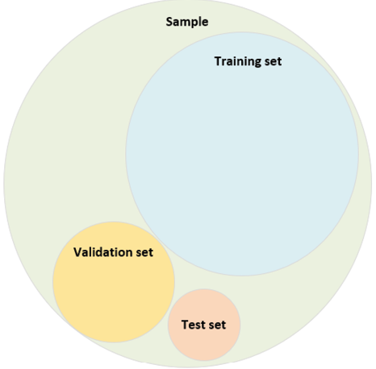
Solution Description - Prediction variable selection
As we wish to determine the eligibility of our applicants for a grant, the logical step in choosing a prediction variables from the ones mentioned before would be:
13. complies with the requirements for the subsidy
Most of the data in this column is null, but there is a sample sizable enough to split into test and training sets

Slide 12
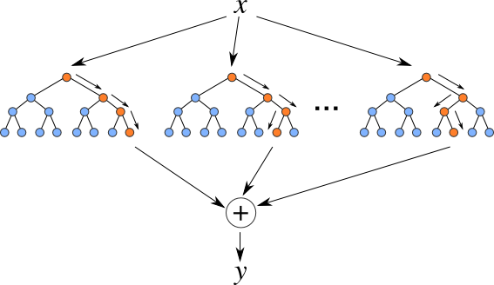
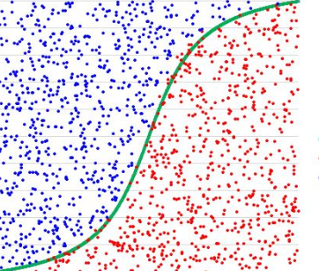
Solution description - Model exploration
33% Test
67% Training
86554 registers
Two types of models were implemented and compared: Random forest and logistic regression, the precision of both methods was very similar, therefore, we opted to use the logistic regression as it is a simpler model for categorization
Notes:
We use Random Forest, Logistic Regression and Gradient Boosting Classifierbecause all of them have good performance and they are very useful on classification models. Random forest and Logistic Regression has better F1 score . F1 score is a measure of a test's accuracy. It is calculated from the precision and recall of the test and it is very accurate on the result.
we did not determined the max depth of the forest, therefore using that methodology we might risk to over adjust the model and make wrong predictions
Random_state = 42 defined for reproducibility

Slide 13
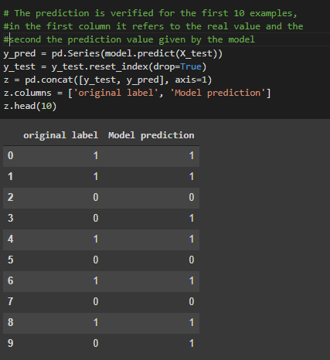
Results
Model precision 88.1%
Should be granted / granted (Positive)
4119
Should not be granted / granted (False Positive) 4013
Should be granted/ Not granted (False Negative) 1219
Should not be granted/ Not granted (Negative) 19212

Slide 14
Conclusions: implications of this project in a new normal
As we live in a emerging economy resources are limited, this is also true for funds dedicated to alleviate the economic crisis caused by Covid-19 quarantine measures, resources should be optimized in order to grant money either to those in greater need or those that would be more prone to reactivate the economy.
Thus, this project offers a glimpse of a possible automated system that grants unemployement subsidies powered by previous and actual user data, also reducing costs of location and agents to the family compensation fund
Notes:
As we live in a emerging economy resources are limited, this is also true for funds dedicated to alleviate the economic crisis caused by Covid-19 quarantine measures, resources should be optimized in order to grant money either to those in greater need or those that would be more prone to reactivate the economy.
Thus, this project offers a glimpse of a possible automated system that grants unemployement subsidies powered by previous and actual user data, also reducing costs of location and agents to the family compensation fund

